Slide 1

Uno
UML
By: Erik Dunlap and Kaeden Daly

Slide 2
Card
-rank: int -suit: int
+fixWildSuit(): void +getRank() const: int +getSuit() const: int +virtual changeWild: void +virtual getPlus() const: bool +virtual getFileName() const: string
UML Diagram (Cards)
ReverseCard
+ReverseCard() +getFileName() const: string +friend operator<<(): ostream&
BasicCard
-plus: bool
+BasicCard() +BasicCard() +getPlus() const: bool +getFileName() const: string +friend operator<<(): ostream&
WildCard
-plus: bool
+WildCard() +changeWild(): void +getPlus() const: bool +getFileName() const: string +friend operator<<(): ostream&
SkipCard
+SkipCard() +getFileName() const: string +friend operator<<(): ostream&

Slide 3
UML Diagram (Aggregation)
Player
-hand: vector<Card*> -size: int -AiPlayer: bool +lastPlayedCard: Card*
+getSize() const: int +getHand() const: vector<Card*> +getCard() const: Card* +setAi(): void +giveCard(): void +decideCard(): int +findCardType(): bool +playCard(): bool +playTurn(): void +~Player()
Deck
-numCard: int +cards: vector<Card*> +playPile: vector<Card*>
public: +fillDeck(): void +shuffle(): void +startGame(): void +drawTop(): Card* +onPlay(): bool +~Deck()
Card*
…
…
0..*
0..1
0..1
0..*

Slide 4

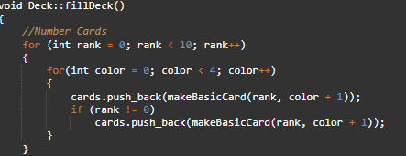
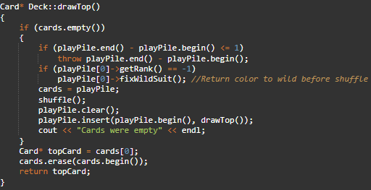

Deck Creation

Slide 5
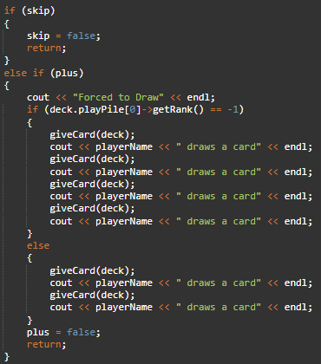
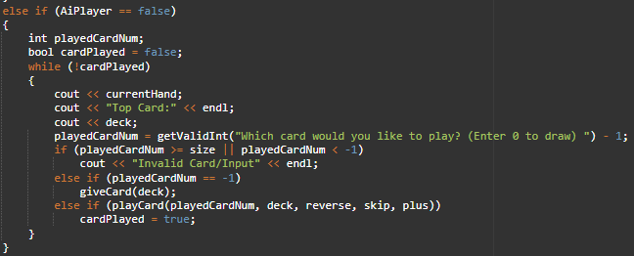
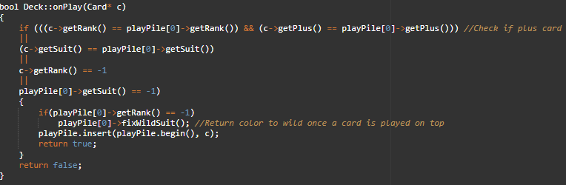
Average Player Turn
Checking For Skipped Turns
Getting which card a player wants to play
Checking the validity of the chosen card

Slide 6
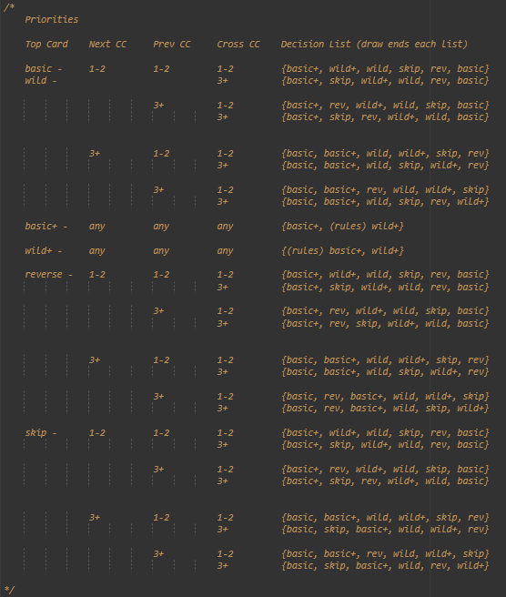
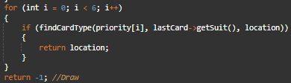
Creating the AI’s Card choice with a priority list

Slide 7
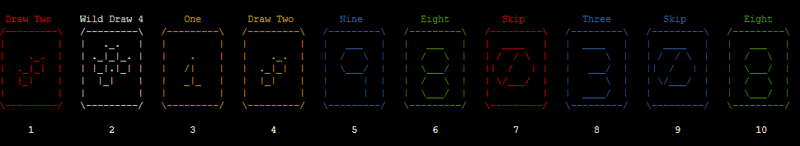
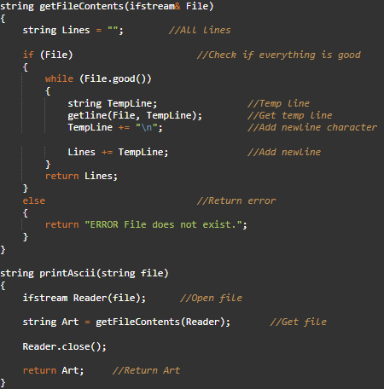
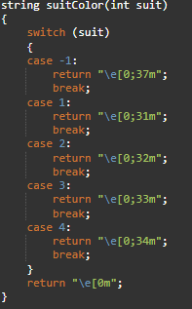
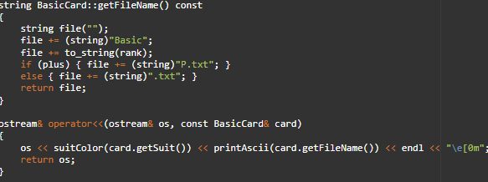
Artwork

